Slide 1

KAKATIYA INSTITUTE OF TECHNOLOGY
& SCIENCE FOR WOMEN
A SEMINOR ON
TERAHERTZ COMMUNICATIONS
PRESENTED BY:
D.RAGASRI (226B5A0408)

Slide 2
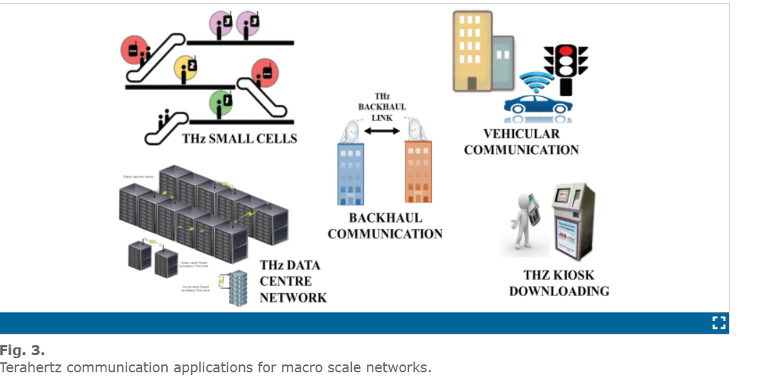
ABSTRACT:
Terahertz (THz) communication is an emerging technology that utilizes the terahertz frequency range (0.1 to 10 THz) for wireless data transmission.
This novel approach leverages the unique properties of THz waves, such as high bandwidth and low latency, to facilitate ultra-fast communication systems capable of meeting the demands of next-generation networks.

Slide 3
CONTENTS:
Introduction
Terahertz communication uses
Prototype THz
Challenges with THz communication
Application
Advantages
Disadvantages
Proposed system
Conclusion

Slide 4
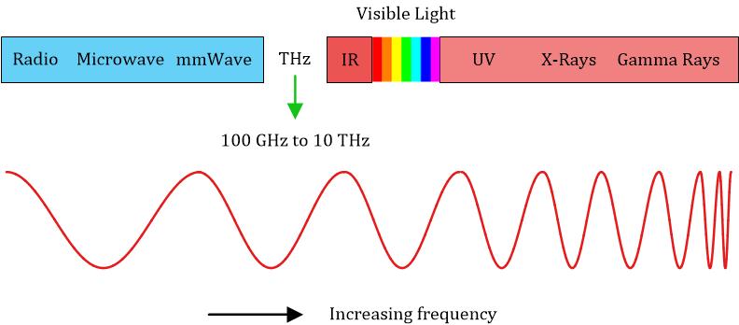
INTRODUCTION:
Terahertz (THz) band communication are eminent as key aiding technology for next generation wireless system that assures to integrate a wide range of data demanding and delay sensitive application. Advancement in optical, electronic, and plasmonic transceiver design, integrated, adaptive, and efficient THz systems are no longer far-fetched.

Slide 5
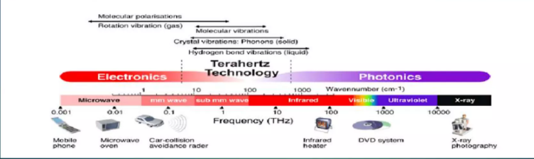
The terahertz band (0.3 thz to 10 thz)is the next edge in wireless communications for its knack to expose significantly wider divisions of unutilized bandwidth.
Though radio channels above 100 ghz are little known, and many terahertz communication models had been shown in few past years.

Slide 6
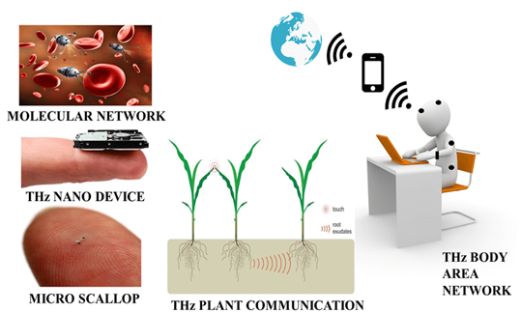
THz uses:
THz-band communications are expected to play a vital role in the upcoming sixth-generation of wireless mobile communication, enabling ultra-high bandwidth communication prototypes.
Despite the fact that by definition the THz band extends from 300ghz to 10thz,researchers have found it convenient to categorize beyond-100GHz applications as thz communications, below which the millimeter- wave bands of 5G are defined.

Slide 7
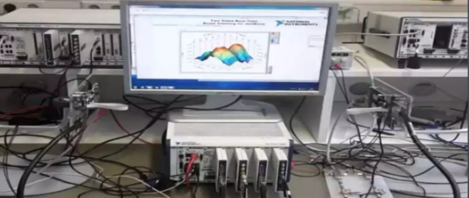
PROTOTYPING THz :
Engineers, for instance, can employ these prototypes in real-time and over-the-air(OTA) setups in a variety of scenarios. Here two things are fundamental in creating prototypes for new technologies like terahertz communication: flexible hardware and software that allow engineers to iterate and optimize designs quickly.
Figure 3:- an SDR-based mmWave prototype at NYU wireless is reminiscent of the infrastructure required for investigating terahertz-band characteristics.

Slide 8
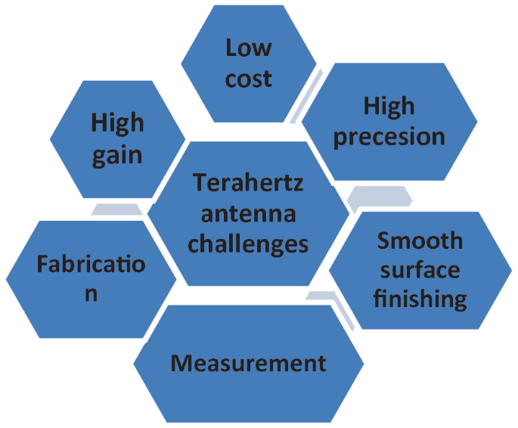
Challenges with THz communication
THz communication band’s has high propagation losses and power limitations results in very short communication distance.
Frequency dependent on molecular absorptions results in band-splitting and band reduction.
Signal misalignment and blockage are also more severe at the THz band.

Slide 9
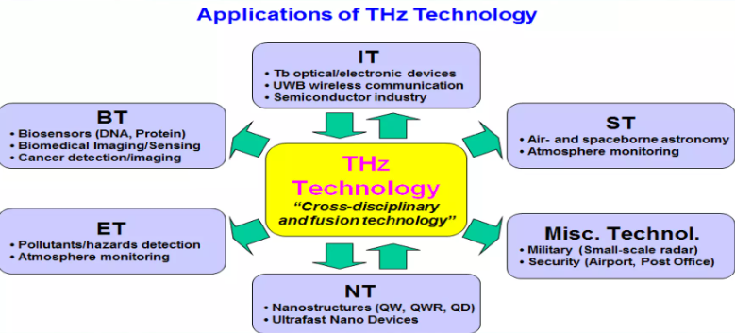
APPLICATIONS:
THz sensing and imaging
Localization
6G and beyond cases
Implementation aspects
Roles in machine learning
Health and privacy concern
Drone to drone communications

Slide 10
ADVANTAGES:
Enhanced energy.
Backward compatibility with mmwave bands.
THz communication band has a lesser impact on the human body because of its non ionizing nature
Advance image and sensing

Slide 11
DISADVANTAGES:
Atmospheric absorption
Required clear line of sight
Complex construction
Limited range

Slide 12
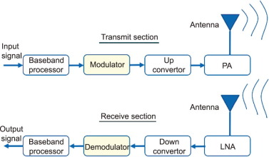
THz PROPOSED SYSTEM:
The 5G dynamo is opening the floodgates of wireless bandwidth, and once mmWave bands move toward wider adoption and proliferation for 5G and other communication use cases, terahertz band like 140 GHz are inevitably going to be the next in line.
That may not be very far away amid the speech of wireless technology advancements, so industry player need to start preparing for wireless communication above 100GHz.

Slide 13
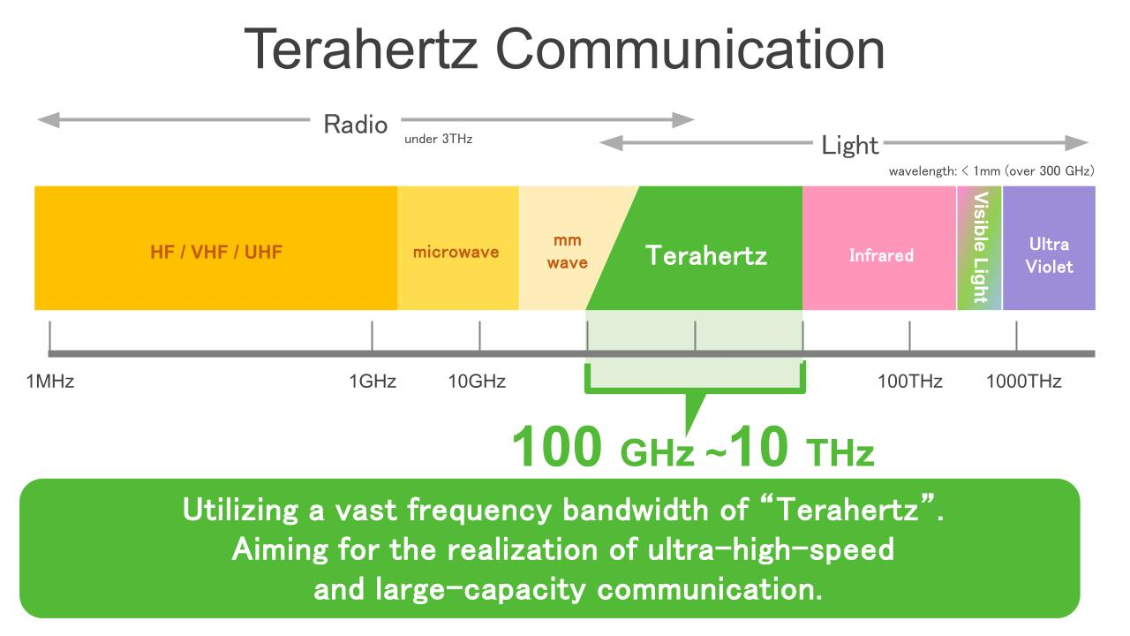
CONCLUSION:
In conclusion, terahertz (THz) communication holds significant promise for the future of wireless technology, offering advantages such as high bandwidth, low latency, and enhanced security. Its ability to support dense data transmission and provide immunity to electromagnetic interference makes it particularly appealing for short-range applications and high-demand environments. However, challenges like limited range, atmospheric absorption, and the need for complex equipment must be addressed for practical implementation.

Slide 14
THANK YOU

